Slide 1
LEARNING FROM DATA Stock Market Analysis

Slide 2
Group Members
Surname & Initials Student no:
Gwala SP 217054690 Mqadi MN 221037901
Mokwebo BRK 201441684

Slide 3
Introduction
Success in any financial market requires one to identify solid investments. When a stock or derivative is undervalued, it makes sense to buy. If it's overvalued, perhaps it's time to sell. While these finance decisions were historically made manually by professionals, technology has ushered in new opportunities for retail investors. Data scientists, specifically, may be interested to explore quantitative trading, where decisions are executed programmatically based on predictions from analysis and trained models.
Stocks can be a valuable part of your investment portfolio. Owning stocks in different companies can help you build your savings, protect your money from inflation and taxes, and maximize income from your investments. It's important to know that there are risks when investing in the stock market.
Historically, long-term equity returns have been better than returns from cash or fixed-income investments such as bonds. However, stock prices tend to rise and fall over time. Investors may want to consider a long-term perspective for their equity portfolio because these stock-market fluctuations tend to smooth out over longer periods.
Taxes and inflation can impact your wealth. Equity investments can give investors better tax treatment over the long term, which can help slow or prevent the negative effects of both taxes and inflation. Some companies pay shareholders dividends or special distributions. These payments can provide you with regular investment income and enhance your return.

Slide 4
What is the best long-term investment strategy for a R100,000?

Slide 5
Markets to be
Analyzed
S & P 500 Giants Microsoft & Amazon
Cryptocurrency Giant Bitcoin
Inflation

Slide 6
Microsoft
As one of the most diversified companies, Microsoft (MSFT -0.65%) has strong positions in operating systems, video games, cloud computing, productivity software, and even social media with LinkedIn. This year, the company will also expand its digital advertising business through a partnership with Netflix
Microsoft's varied revenue streams proved their strength in 2022, with segments less affected by economic challenges able to maintain earnings growth despite declines in specific markets. The company's stock is down 22% year over year. However, its growth of 157% over the last five years proves it is a reliable long-term investment.
In mid-January, news broke that Microsoft is considering investing 10USD billion in OpenAI, an artificial intelligence (AI) company best known for its AI chatbot ChatGPT. The deal would expand Microsoft's stake in the company after it initially invested 1USD billion in 2019. Microsoft has a share in the company and now ChatGPT has a paid for service to access the Chatbot. This will increase its revenue.

Slide 7
Amazon
Brand Finance recognized Amazon as the most valuable brand in the world in 2023. That distinction highlights. The tremendous popularity its marketplace enjoys among consumers. Indeed, Amazon draws more visitors each month than any other digital shopping destination, and it accounted for 38% of online retail sales in North America and Western Europe last year. Its Prime membership program creates even more value for consumers, and its massive logistics network adds value for merchants, accelerating the network effects inherent to its business model.
Ameco Research estimates that global e-commerce sales will grow at 13.6% annually to reach 15USD trillion by 2030. Amazon is exceptionally well positioned to benefit from that trend.
Amazon Web Services (AWS) was the first hyperscale public cloud, and it still dominates the market for cloud infrastructure and platform services (CIPS). AWS accounted for 32% of CIPS spending in the fourth quarter last. year, putting it nine percentage points ahead of the runner-up Microsoft Azure.

Slide 8
Bitcoin
The blockchain technology underlying Bitcoin and other cryptocurrencies has been hailed as a potential game-changer for a large number of industries, from shipping and supply chains to banking and healthcare. By removing intermediaries and trusted actors from computer networks, distributed ledgers can facilitate new types of economic activity that were not possible before.
This potential makes for an attractive investment to people who believe in the future of digital currencies. For people who believe in that promise, investing in cryptocurrency represents a way to earn high returns while supporting the future of technology.
Another common reason to invest in cryptocurrency is the desire for a reliable, long-term store of value. Unlike fiat money, most cryptocurrencies have a limited supply, capped by mathematical algorithms. This makes it impossible for any political body or government agency to dilute its value through inflation. Moreover, due to the cryptographic nature of cryptocurrencies, it is impossible for a government body to tax or confiscate tokens without the cooperation of the owner.
Bitcoin has grabbed the attention of the world over the last decade, as it could represent a new form of decentralized money. The ability to have a trustless payment system without a third-party intermediary has many people betting on its future being bright. Bitcoin is the fastest-growing cryptocurrency in the world. This makes Bitcoin an important cryptocurrency and a good investment option for you to make for the market.

Slide 9
Inflation
Inflation occurs when the supply of money increases relative to the level of productive output in the economy. Prices tend to rise because more dollars are chasing relatively fewer goods. Another way of stating this phenomenon is that the purchasing power of each money unit declines.
This means that inflation can have a huge impact on the way we save and invest our money: it can either reduce the value of your investment portfolio over time, or you could possibly use it to your advantage to help your investments grow.

Slide 10
Analyzing Markets

Slide 11
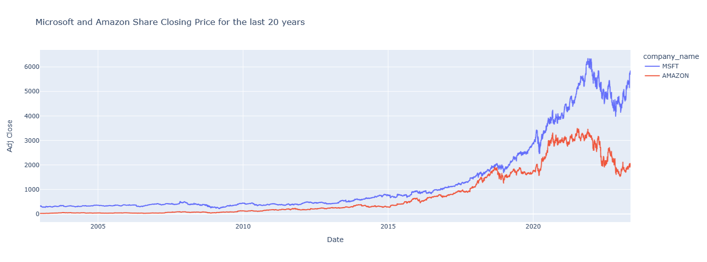
Closing Price: Microsoft & Amazon
Microsoft stock has been on an up trend from 2003 till 2021 Dec then it decreased a little bit but did not move more than the average increase it had previously.
Amazon stock has been increasing from 2003 Jan till 2020 end of August then from there the stock price has been fluctuating between the period 2020 Sep till 2022 April.

Slide 12
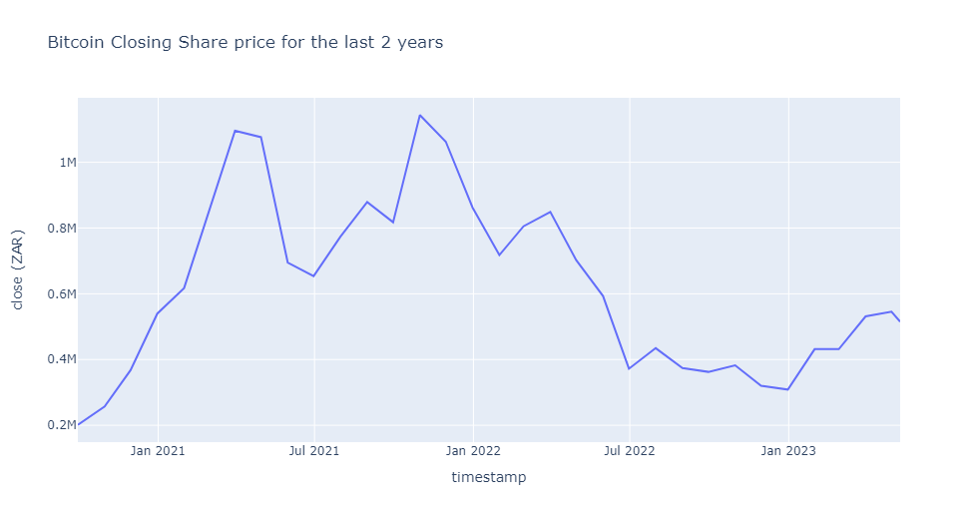
Closing Price: Bitcoin
Trend was increasing until March 2021 and dropped a bit and increased again until October 2021
After October 2021 it dropped drastically may be to Russia and Ukraine war.

Slide 13
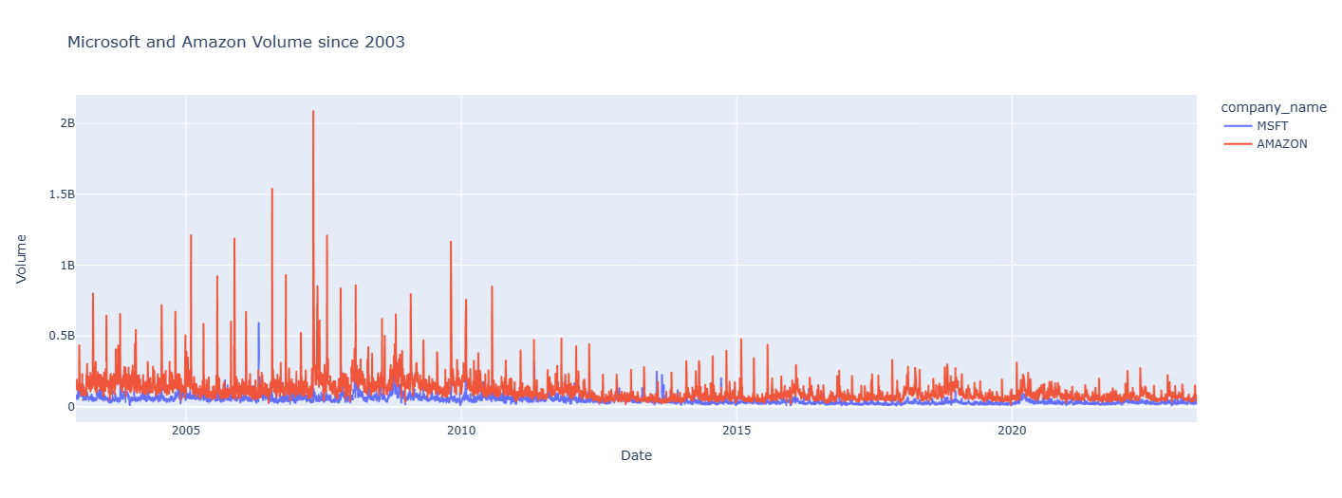
Sales Volume: Microsoft & Amazon
The volume for sales of Amazon is higher than for Microsoft because Amazon has been. providing their services online which showed that most people trusted it with online transactions compared to Microsoft which was not that popular online as compared to Amazon.

Slide 14
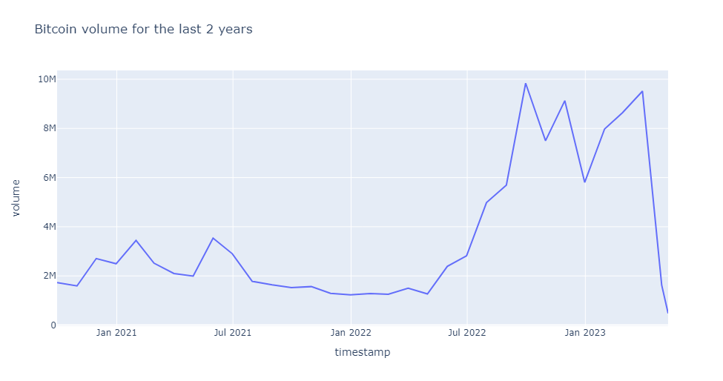
Sales Volume: Bitcoin
Bitcoin was low most people thought it was the right time to buy Bitcoin since it was cheap so they hoped that it might gain strength
Since the ongoing war made it lose more value hence you saw a lot of people dropping their investments in it since it was too risky to invest in.

Slide 15
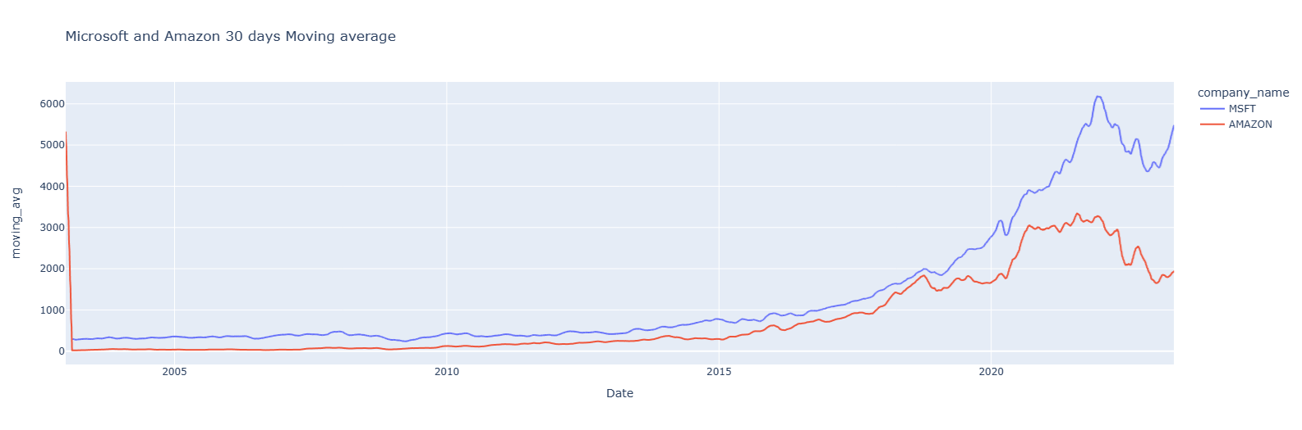
30-day Moving Average
The moving average for Microsoft is showing an uptrend so it is most likely to maintain that trend given its investments and its products which shows dominancy in the computer space and its expansion in the technological space.

Slide 16
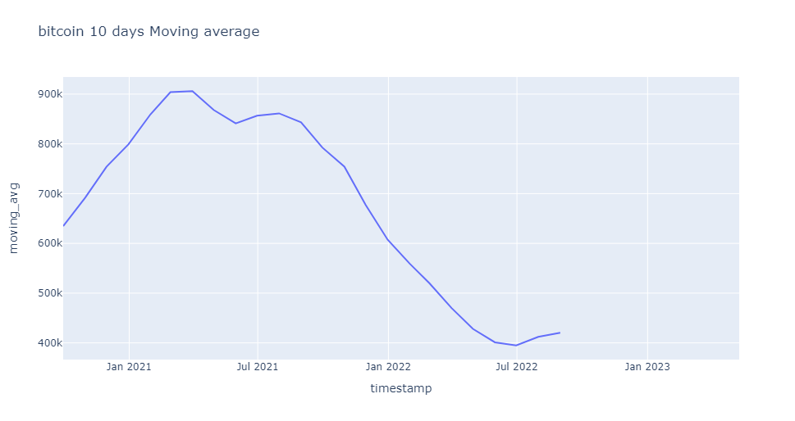
Bitcoin: 10-day Moving Average
A rolling sum of 10 days due to not having enough data and using a rolling sum of higher days can be misleading but we can see that the moving average is going down since 2021 as we mentioned bitcoin has lost value in the past 2 years

Slide 17
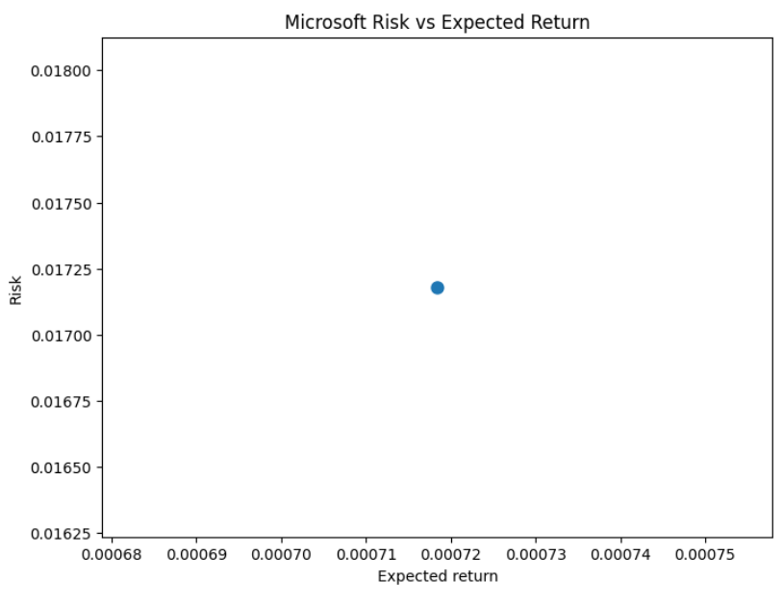
Microsoft Risk vs Expected Return
The expected return to Risk is reasonable considering that we are looking to invest long-term.

Slide 18
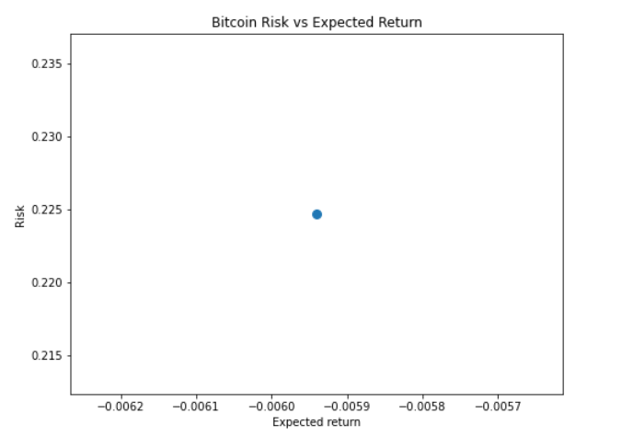
Bitcoin Risk vs Expected Return
Bitcoin has the highest risk as to the other stocks and the returns are a loss so it would not be wise to invest in it due to the. volatility of the stock and it not yielding enough returns for a profit.

Slide 19
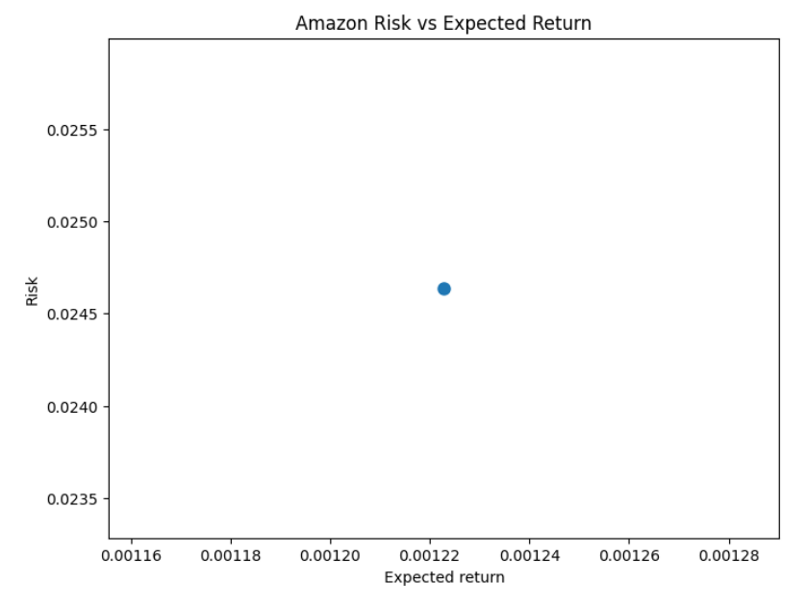
Amazon Risk vs Expected Return
The expected return to Risk is reasonable considering that we are looking to invest long-term

Slide 20
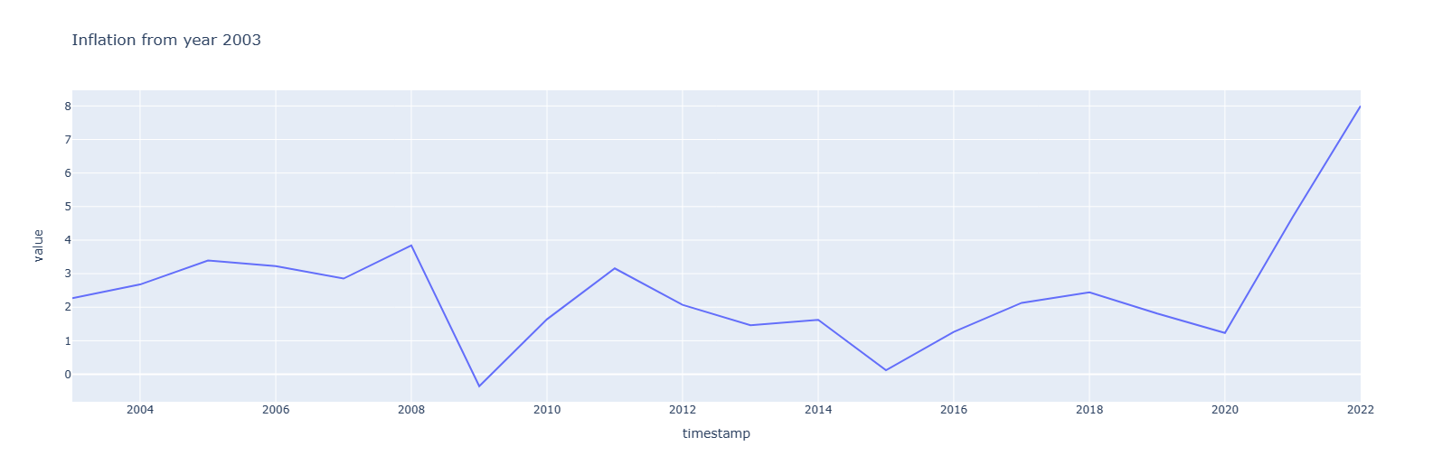
Inflation Rate
The overall trend is increasing even though there was a drastic drop in 2008. In 2020 we observed a sharp increase in inflation, and it has never shown any sign of dropping.

Slide 21
Inflation Rate
The overall trend is increasing even though there was a drastic drop in 2008. In 2020 we observed a sharp increase in inflation, and it has never shown any sign of dropping.

Slide 22
Conclusion
Using the data at hand we can confirm that although markets are about risk-taking and uncertainty.
We would recommend that we invest in Microsoft because out of the 3, it is the one that looks more stable, and it would be appropriate for long-term growth. Both Amazon and Microsoft yield strong long-term returns, but Microsoft has more returns than Amazon.
And, Microsoft and Amazon have proven from the past that they can yield returns over a long period of time. But we recommend Microsoft because it yields better returns.
And on the other hand, Bitcoin is good for short-term gains, but it has a higher risk, so if we were to invest in it, we would have to have a high-risk tolerance.
In summary, Microsoft has a better risk to returns, and investing in them is the best strategy according to our analysis.
Also, inflation seems to be increasingly moving forward.

Slide 23
Reflections
About Markets
We learned how we could manage risks, and understand different kinds of risks (market, credit, and operational risks).
Understanding how the market trends, and literally staying on your feet in order to get the newest insights, bulletins, and technology as well.
Understanding the different marketing strategies, and how they can give you insights into how we can invest
We also learned about Gross Domestic Product and inflation, and that helps with understanding how the economy is and its impacts on some markets.
Most importantly we learned about the power of supply and demand, and how those specify the prices of goods and services. When there is high demand for a specific product than it can be supplied, prices go up, and when supply is high than demand, prices go down.
About Data Analysis
We learned that data needs to be collected and prepared. It is collected from a variety of sources and prepared for analysis.
Data must be visualized in a way that is going to make meaning (trends and graphs need to communicate).
The data should basically tell a story and give insights to the audience.

Slide 24
About Programming
Our programming skills have improved using Python code on Jupyter notebooks because it is not really that difficult, it just needs us to understand. And python has libraries such as seaborn and matplotlib to mention a few, to create graphs and charts.
About this course
This course has been great because we were exposed to data analysis with Python, which indeed we know that many corporate use that for data. analysis and EDA. It is basically market-related and in demand.
Appreciate it because we analyzed data from Excel, and moved to Python, basically knowing both and knowing that Python can go an inch up and very much quicker than Excel.
Also, great because we learned the basics of Linux, which basically an average IT person should have those basics.
The lecturer, Prof. Langerman is awesome!!!

Slide 25
THANK YOU

